Slide 1
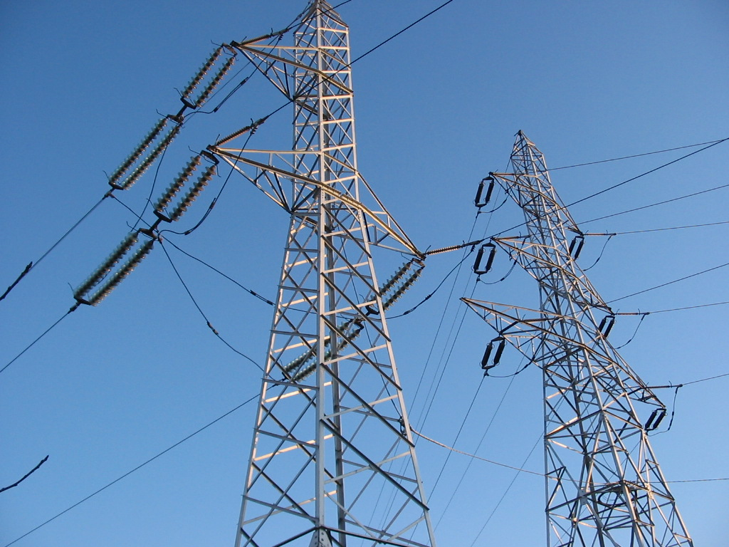
Energy
TEAM DAGGER
George Bigham, Dawn Brenner, Adam Pritchett

Slide 2
Project hypothesis
A country’s energy consumption and use of “green”
energy increases with prosperity

Slide 3
OUR QUESTIONS
Is energy consumption related to a country’s prosperity?
Is energy consumption increasing or decreasing over time?
Do more prosperous areas use more “green” energy.
Notes:
Describe the questions you asked, and what motivated us to ask them Describe whether you were able to answer these questions to your satisfaction, and briefly summarize your findings

Slide 4
summary
Energy capacity increases with population and HDI in most cases
Energy capacity is dependent on other variables (politics, war, etc.)
Energy consumption per capita is mostly flat globally and in most geographic regions
Energy consumption per capita is decreasing in the US and increasing in Middle East and Asia
Energy cap/consump? of “green” fuel sources is ??? Compared to pop/HDI??
Notes:
Describe whether you were able to answer these questions to your satisfaction, and briefly summarize your findings
THIS SHOULD INCLUDE NUMERICAL FROM DATA ANALYSIS

Slide 5




Our Data
CAPACITY
CONSUMPTION
HUMAN DEVELOPMENT INDEX (HDI)
POPULATION
Notes:
Elaborate on the questions you asked, describing what kinds of data you needed to answer them, and where you found it
Describe the exploration and cleanup process
Present and discuss interesting figures developed during exploration, ideally with the help of Jupyter Notebook

Slide 6
Insights / PROBLEMS from data discovery
Political/geographical changes over recent history affect data
Official country names vs aka names are problematic when merging data from different sources
Data isn’t available for all countries

Slide 7

DATA Analysis

Slide 8
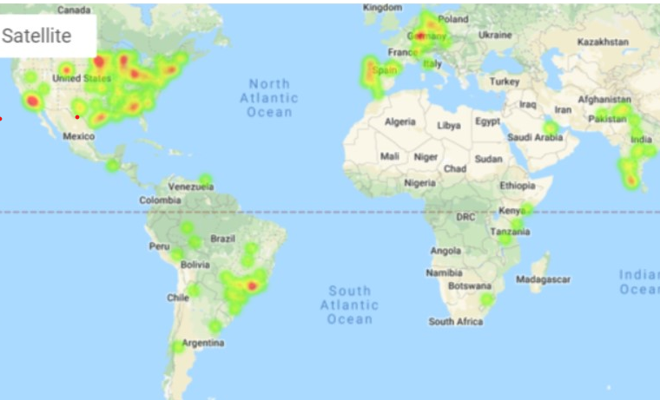
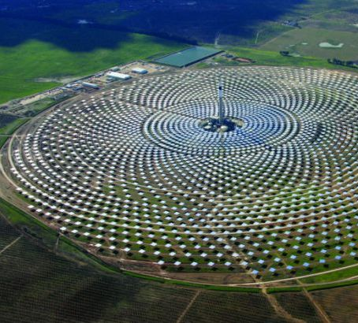
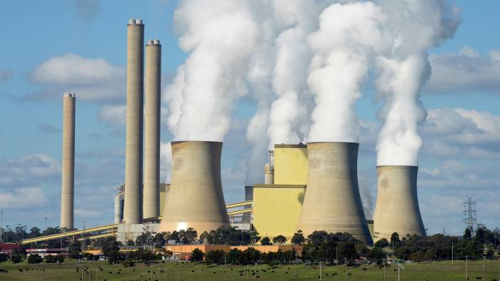
Energy capacity
Maximum energy production capability calculated from power plant commissioning of all fuel types
Source: Global Power Plant Database
Notes:
Discuss the steps you took to analyze the data and answer each question you asked in your proposal Present and discuss interesting figures developed during analysis, ideally with the help of Jupyter Notebook

Slide 9
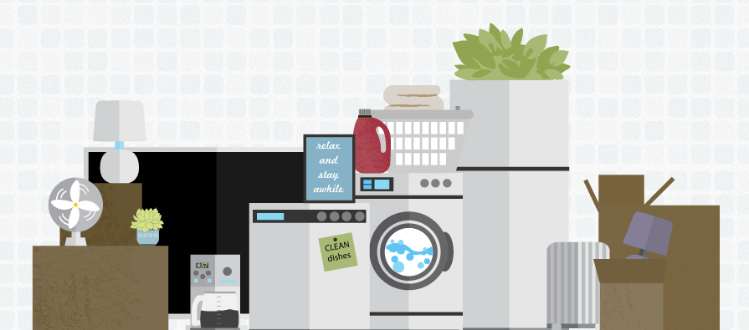
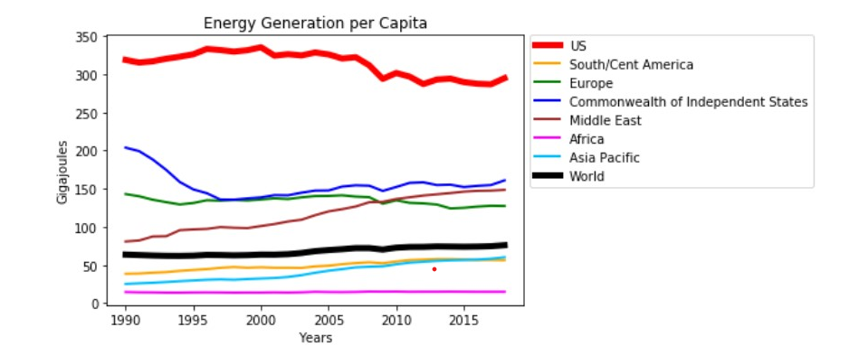
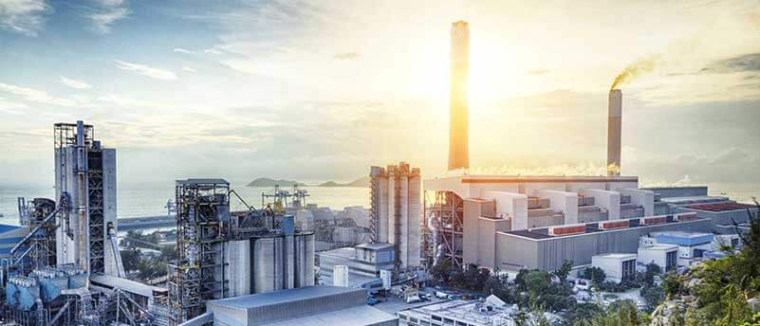
Energy consumption/ Generation
Add graph of non-per capital generation over time
Total amount of energy consumed - residential, commercial, and industrial
Source: BP Statistical Review of World Energy
Notes:
Discuss the steps you took to analyze the data and answer each question you asked in your proposal Present and discuss interesting figures developed during analysis, ideally with the help of Jupyter Notebook
Discuss your findings. Did you find what you expected to find? If not, why not? What inferences or general conclusions can you draw from your analysis?

Slide 10
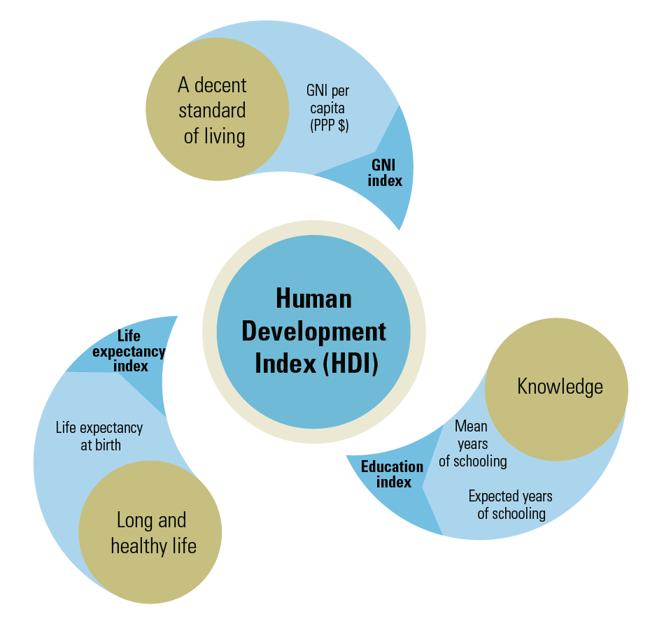
Human development Index (HDI)
Composite statistic of life expectancy, education, and per capita income indicators used to rate a country’s prosperity
Source: United Nations Human Development Data
Add graph of HDI over time
Notes:
Discuss the steps you took to analyze the data and answer each question you asked in your proposal Present and discuss interesting figures developed during analysis, ideally with the help of Jupyter Notebook
Discuss your findings. Did you find what you expected to find? If not, why not? What inferences or general conclusions can you draw from your analysis?

Slide 11
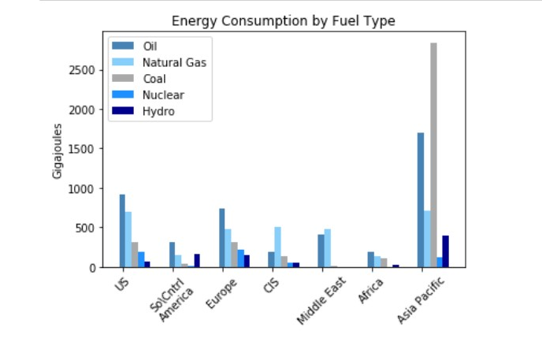

Energy consumption by fuel type
Add graph of population over time
Count of humans in each country
Source: BP Statistical Review of World Energy
Notes:
Discuss the steps you took to analyze the data and answer each question you asked in your proposal Present and discuss interesting figures developed during analysis, ideally with the help of Jupyter Notebook
Discuss your findings. Did you find what you expected to find? If not, why not? What inferences or general conclusions can you draw from your analysis?

Slide 12
Post Mortem
Find alternative data sources
Search for missing data (Africa)
Baseline capacity before 1990
Learn how to label Google Maps
Research other indicators for areas where HDI didn’t correlate with energy use/capacity
Notes:
Discuss any additional questions that came up, but which you didn't have time to answer:
What would you research next, if you had two more weeks?

Slide 13

Questions

